Slide 1

Smart Air Quality Monitoring System

Slide 2

Introduction to Air Quality Monitoring
Air quality monitoring involves assessing atmospheric conditions for pollutants. Our system uses advanced gas sensors to provide real-time data.
Real-time Sensing
Continuous monitoring using gas sensors for immediate data acquisition.
Environmental Impact
Detecting pollutants crucial for environmental health and policy-making.
Health Implications
Monitoring harmful gases directly impacts respiratory and overall human health.

Slide 3
Project Objectives
IoT System Development
Design and implement an IoT-based air quality monitoring system.
Air Quality Classification
Categorise air quality into GOOD, MODERATE, or BAD based on sensor readings.
Local & Remote Display
Present data on an OLED display and a web-based Grafana dashboard.
Alert System
Integrate a buzzer for immediate alerts on detecting poor air quality.
Data Storage & Visualisation
Implement real-time storage and graphical visualisation of sensor data.

Slide 4






System Architecture Overview
The system's modular design ensures efficient data flow from sensing to visualisation.
ESP32 Microcontroller
Core processing unit for sensor data acquisition.
MQ Sensors (MQ2 & MQ135)
Detects various gases, providing raw air quality data.
WiFi Module
Enables wireless connectivity for data transmission.
MQTT Broker
Facilitates secure, lightweight messaging for IoT devices.
InfluxDB
Time-series database for efficient storage of real-time data.
Grafana Dashboard
Visualises sensor data, trends, and air quality status.

Slide 5
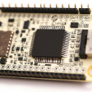
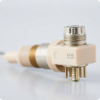
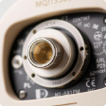
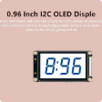

Hardware Components
Selected hardware ensures robust performance and accurate measurements.
ESP32-S3 Dev Board
The brain of the system, offering Wi-Fi and Bluetooth capabilities.
MQ2 Gas Sensor
Detects LPG, smoke, methane, and other combustible gases.
MQ135 Air Quality Sensor
Monitors CO2, benzene, ammonia, and alcohol vapours.
OLED 0.96" I2C Display
Compact screen for local real-time air quality readings.
Passive Buzzer
Provides audible alerts for critical air quality levels.
Additional components: jumper wires, breadboard, and power supply for system integration.

Slide 6

Software Tools & Libraries
A suite of powerful tools and libraries ensures seamless operation and data management.
Arduino IDE (C/C++)
Primary environment for programming the ESP32 microcontroller.
MicroPython (Thonny)
Used for rapid prototyping and initial sensor testing.
Mosquitto MQTT Broker
Lightweight open-source message broker for IoT communication.
InfluxDB
High-performance time-series database optimized for sensor data.
Grafana
Powerful open-source platform for data visualisation and analytics.
Key Libraries:
WiFi: For ESP32 network connectivity.
PubSubClient: MQTT client library for ESP32.
SSD1306: Driver for the OLED display.
Adafruit_GFX: Graphics library for OLED content rendering.

Slide 7














System Workflow & Output
The integrated process from data acquisition to real-time alerts and visualisation.
Threshold Comparison
Sensor Readings
Raw data compared against predefined air quality thresholds.
MQ2 & MQ135 values are sampled every 5 seconds.
OLED Display
Current air quality status and sensor values shown locally.
Buzzer & LED Alerts
Auditory and visual warnings for critical air quality levels.
MQTT Publication
Data is published to designated MQTT topics.
Grafana Visualisation
InfluxDB Storage
Real-time trends and historical data displayed on the dashboard.
Time-stamped sensor data securely stored for historical analysis.

Slide 8
Grafana Dashboard Overview
The central hub for comprehensive air quality monitoring and analysis.
100%
100%
Real-time Graphs
Air Quality Status
Live plots of MQ2 and MQ135 sensor values for immediate insights.
Clear indication of current air quality (Good, Moderate, Bad) at a glance.
100%
100%
Timestamp Accuracy
Annotated Peaks
Precise timestamps for all data points ensure accurate historical tracking.
Markers highlight significant air quality events and critical thresholds.

Slide 9
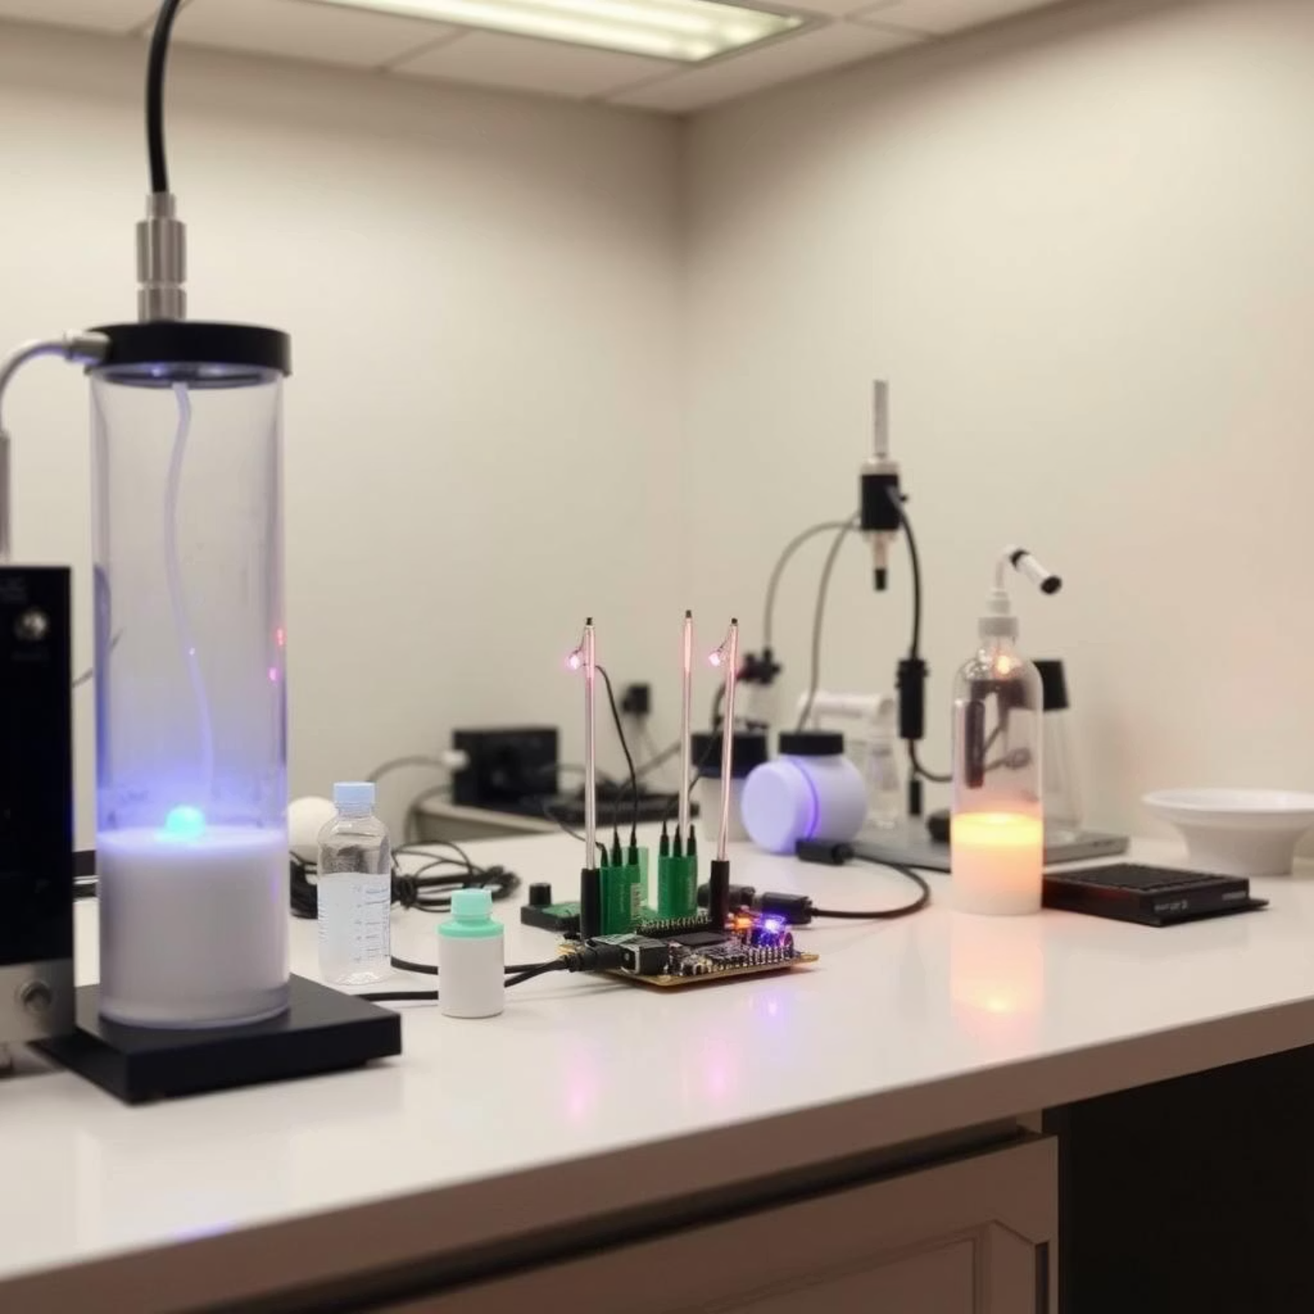
Testing & Validation Results
Rigorous testing confirms system accuracy and reliability across various conditions.
Good Air: Low gas levels, indicated by Green LED.
Moderate Air: Intermediate gas levels, indicated by Blue LED.
Bad Air: High gas levels, indicated by Red LED and buzzer activation.
Accuracy enhanced through empirical threshold calibration.
Successful MQTT communication validated data integrity.
OLED display provides clear, legible output in all conditions.

Slide 10
Conclusion & Future Work
Conclusion
Future Improvements
Real-time Monitoring
Mobile App Integration
Achieved a fully functional real-time air quality monitor.
Develop a dedicated mobile application for remote monitoring and control.
Efficient Data Flow
Additional Sensors
Seamless data transmission from sensor to cloud dashboard.
Incorporate CO and PM2.5 sensors for more comprehensive air analysis.
Feature Integration
All specified features—OLED, buzzer, MQTT, InfluxDB, Grafana—fully operational.
SMS Alert System
Implement SMS notifications for critical air quality events.
AI Prediction
Integrate AI/ML for predictive air quality analysis.

